Slide 1
Comparison of similarity and dissimilarity between Toronto and New York

Slide 2
1. Introduction
Comparing the similarity or dissimilarity of Toronto and New York:
Both Toronto and New York cities are diverse in their respective countries. Comparing the two cities would be advantageous to figure out the similarity or dissimilarity between them. The will benefit for different target audiences, mainly tourists, working immigrants, residents, and to administrative units.

Slide 3
2. Data Acquisition
We have different sources for Toronto and New York cities
Data sets for Toronto come from two sources
Wikipedia page https://en.wikipedia.org/wiki/List_of_postal_codes_of_Canada:_M which mainly contains Postal code address in Canada
Csv file located in http://cocl.us/Geospatial_data which mainly comprises the geographical coordinates of the postal codes in Canada
Hence, we scrape the data from the Wikipedia page, wrangle it, clean it, and we get the list of postal codes, boroughs, and neighborhoods. Then we merge it with the csv file based on postal codes.
Data sets for New York
Is freely available at https://geo.nyu.edu/catalog/nyu_2451_34572 , but it is already downloaded by the instructor of this course and we can access the csv file which contains list of boroughs, neighborhoods, latitude, and longitudes.

Slide 4
3. Methodology
3.1. Data cleaning
For the Toronto data set, we clean the data based on the following rules
Only the cells that have an assigned borough will be processed. Borough’s that were not assigned get ignored.
More than one neighborhood can exist in one postal code area with the neighbourhoods separated with a comma.
If a cell has a borough but a Not assigned neighbourhood, then the neighbourhood will be the same as the borough.

Slide 5
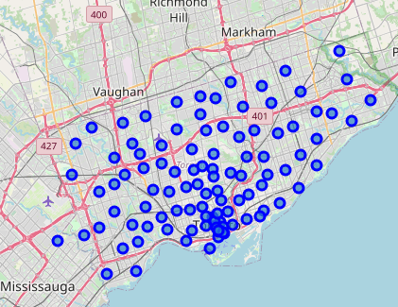
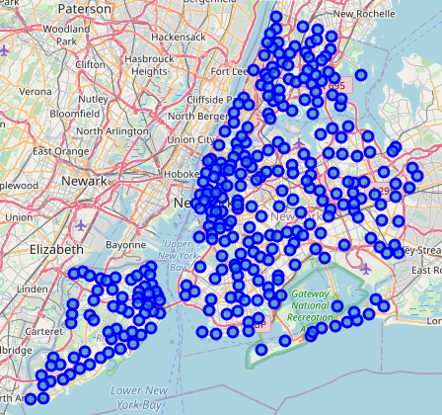
3.2. Data Exploration
Having cleaned the dataset, we have got 10 Boroughs and 103 PostalCode (neighborhoods) for Toronto, and 5 Boroughs and 302 neighborhoods for New York City. The map of cities with the neighborhoods superimposed is shown below, respectively.

Slide 6
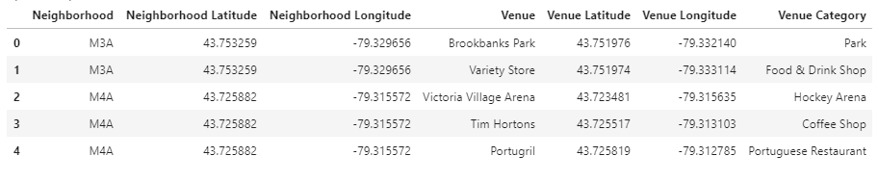
We use the explore function to get the venues within 500 meter radious of each neighbourhood. After exploring the neighborhoods using the Foursqare API, we get 2146 venues in Toronto and 10128 venues in New York which is almost five times that of Toronto.
Fig : Venues in Toronto neighborhoods

Slide 7
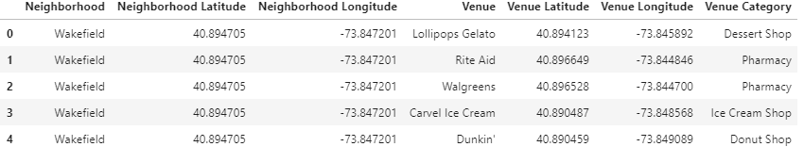
Venues in New York neighborhooods

Slide 8
3.3. Machine Learinig
To analyze the data we performed a technique in which Categorical Data is transformed into Numerical Data for Machine Learning algorithms. This technique is called One hot encoding. For each of the neighbourhoods in Toronto and New York City, individual venues were turned into the frequency at how many of those Venues were located in each neighbourhood
Then we grouped the venues based on similar neighborhoods in both cities and by taking the average of the frequency of occurrence of each Venue Category.

Slide 9
K-means clustering
To make the analysis more interesting, we wanted to cluster the neighbourhoods based on the neighbourhoods that had similar averages then use this feature to group the neighborhoods into clusters.
The clustering is implemented using K-means clustering algorithm. For convenience we use, k to be 5 in both cities. Moreover, we use the Folium library to visualize the neighborhoods in New York City and their emerging clusters.

Slide 10
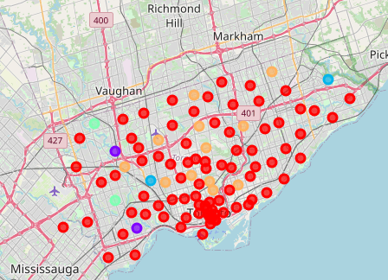
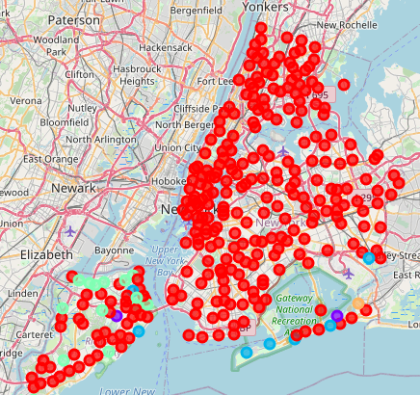
Clustering output map Toronto New York

Slide 11
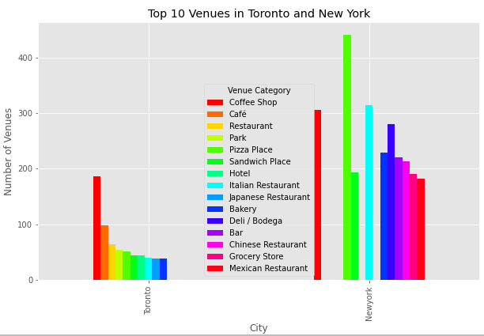
3.4. Data Analysis
Comparison of the top ten venues from Toronto and New York; Coffee shops , café and restaurants are the top three in Toronto whilst Pizza place, Italian restaurants followed by coffee shops are at the top in New York.

Slide 12
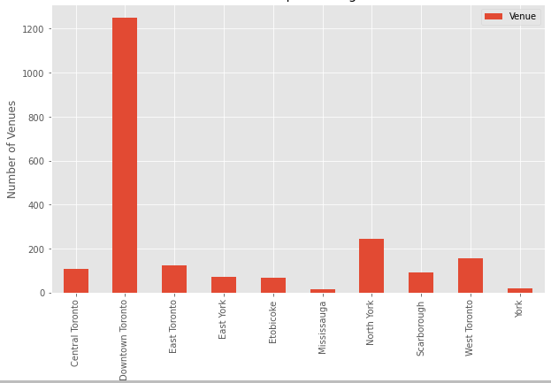
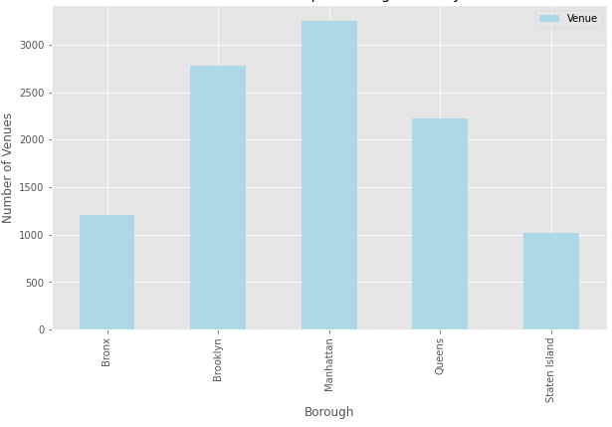
Comparison of number of venues per borough Toronto New York
Notes:
We get ten boroughs in Toronto with downtown Toronto comprises the largest venues where as in New York there are five boroughs where the number of venues in each borough is above 1000.

Slide 13
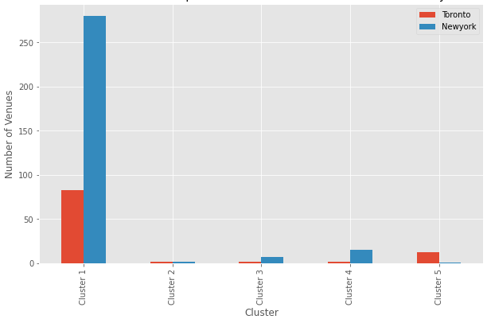
Cluster Analysis
For analysing the clusters, we sorted the venues in each neighbourhood in descending order and take into consideration only the top ten most common venues.
Notes:
The total number of venues in New York city is greater than that of Toronto but cluster 2 and 5. Moreover, Cluster 1 accounts for the largest number of venues in each city.

Slide 14
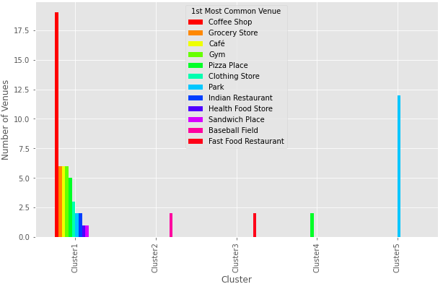
Comparison of the top ten out of the 1st most common venues
Out of the top ten most common clusters, we have taken only the 1st most common venues from each cluster. We have grouped them by their venue category, and below is shown cluster 3 results from both cities for illustration purpose.
Toronto city

Slide 15
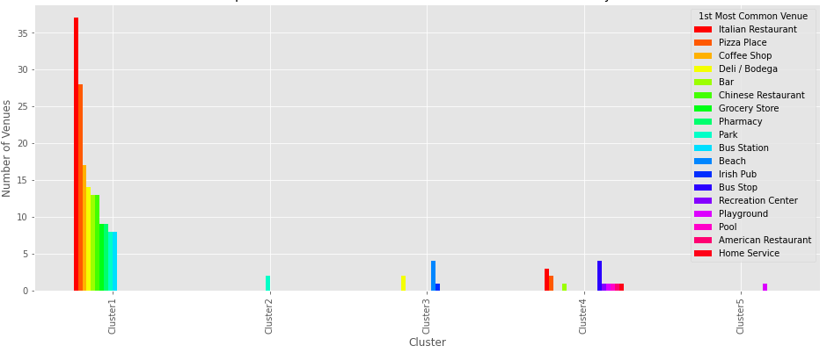
…con’d
New York City:

Slide 16
4. Discussion
After exploiting each neighborhood, we have obtained that New York has nearly 5 times as much venues as Toronto.
The most common venues from each city are completely different. If we take, for example, the top three venues from each city we observe that food zones are in the list in New York whilst hot drink shops and cafes account for the top category in Toronto.
Moreover, there are 10 Boroughs in Toronto while there are only 5 Boroughs in New York. Each Borough in Toronto comprises fewer venue categories compared to the Boroughs in New York.
All in all, New York is more vibrant compared to Toronto as it owns larger number and varieties of venues in each neighborhood within 500 meter radius. Hence, the target audience can easily get the services they require in nearest distances easily.

Slide 17
Conclusion
We utilized numerous Python libraries to fetch the information, control the content and break down and visualize those datasets. We have utilized Foursquare API to investigate the settings in neighbourhoods of Toronto and New York. We also visualized utilizing Matplotlib libraries. Similarly, we applied Folium to picture the clusters of both cities on a map.
This project can be additionally improved with the assistance of more information and distinctive Machine Learning strategies. Additionally, we can utilize all the venues without filtering out only the top ten venues and find out a better outcome about the similarity or dissimilarity of the cities.

